Slide 1
Welcome to the first annual Sean Walla Walla OS presentation
Before we begin…
Sign our S-Grade NDA
Disable all devices capable of connecting to the internet, and recording video and/or audio
Disable all recording software
If the presentation doesn’t start within 5 minutes, it will be delayed again or cancelled

Slide 2
Welcome to the first annual Sean Walla Walla OS presentation
Before we begin…
Sign our S-Grade NDA
Disable all devices capable of connecting to the internet, and recording video and/or audio
Disable all recording software
If the presentation doesn’t start within 4 minutes, it will be delayed again or cancelled

Slide 3
Welcome to the first annual Sean Walla Walla OS presentation
Before we begin…
Sign our S-Grade NDA
Disable all devices capable of connecting to the internet, and recording video and/or audio
Disable all recording software
If the presentation doesn’t start within 3 minutes, it will be delayed again or cancelled

Slide 4
Welcome to the first annual Sean Walla Walla OS presentation
Before we begin…
Sign our S-Grade NDA
Disable all devices capable of connecting to the internet, and recording video and/or audio
Disable all recording software
If the presentation doesn’t start within 2 minutes, it will be delayed again or cancelled

Slide 5
Welcome to the first annual Sean Walla Walla OS presentation
Before we begin…
Sign our S-Grade NDA
Disable all devices capable of connecting to the internet, and recording video and/or audio
Disable all recording software
If the presentation doesn’t start within 1 minute, it will be delayed again or cancelled

Slide 6
Let’s begin!

Slide 7
MEDOS is a new operating system project we are toying with, and can change the way we store and work with archival data (external hard drives)
MEDOS stands for
Meadows
Disk
Operating
System
or Meadows DOS

Slide 8
The actual Meadows operating system is Quantum based, and is planned to be out by May 18th 2049
It will be known as QMDS or Quantum Meadows

Slide 9
This system is entirely different!

Slide 10
MEDOS will run off:
A floppy disk (virtual machines only)
A cassette tape ((virtual machines only)
A CD (virtual machines only)
A DVD (virtual machines only)
A USB drive
An SD card
A portable HDD (Hard disk drive)
A Solid State Drive (SSD) (Currently under development)
Other future portable hardware

Slide 11
MEDOS is network based, a hard drive you can access and use all the files on without even plugging it in
For security reasons, there is also the option to plug it in offline

Slide 12
It can also be used as an extension to a virtual machine, or a separate virtual machine itself
Virtual machine versions also work with older systems like:
Windows 1.0 | Windows 2.0 | Windows 3.0 | Windows 3.1 | Windows 95 | Windows NT 4 | Windows 98 | Windows ME | Windows 2000 | Windows XP | Windows Vista | Windows 7 | Windows 8 | Mac System 1-9.2.2 | Android 1.1 | IOS 1-3.1 | Ubuntu 4.04-18.04 | Arch 0.1-16 | Fedora 1-27 | Mac OS X 10-10.10 | Linux Mint 1-8 | Redhat 1-4 | IBM Warp 1-4 | PC-DOS 1.0-7.1 | MS-DOS 1.0-6.31 | Apple DOS | Solaris | ReactOS | Other

Slide 13
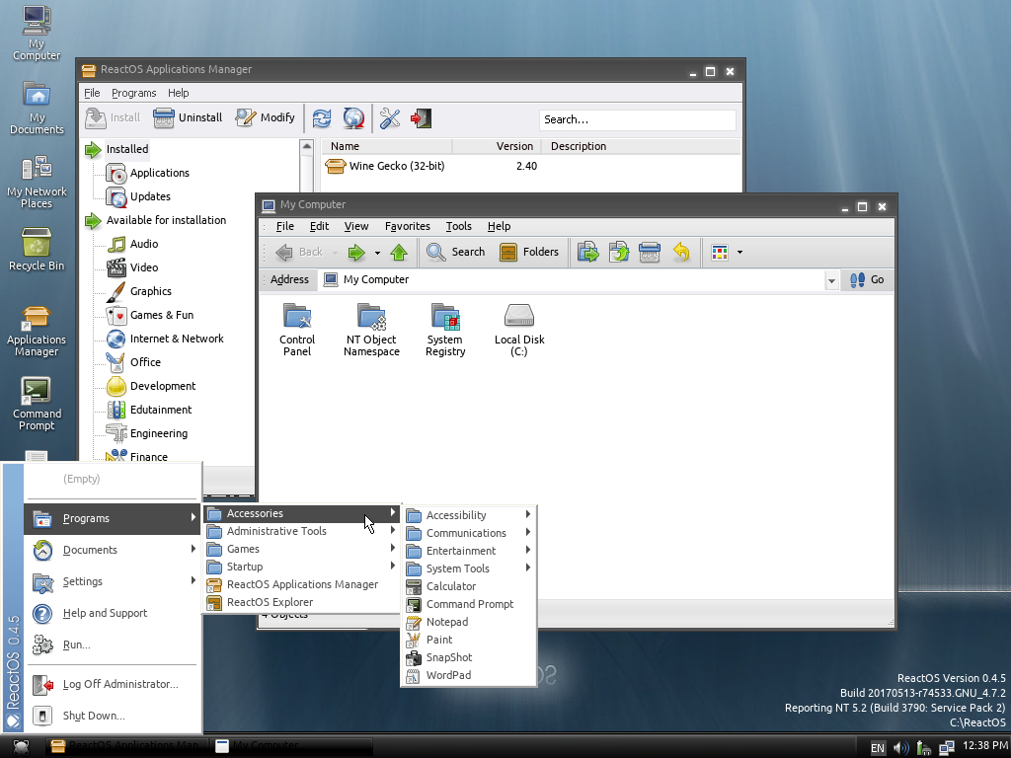
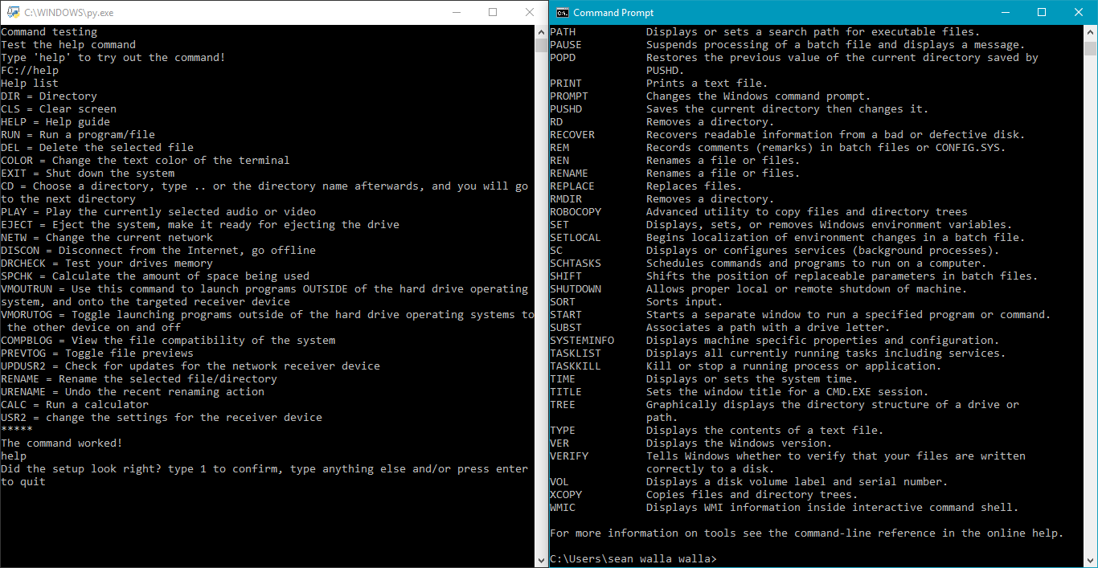
Keep in Mind: This isn’t a full GUI system like Windows or MacOS It isn’t going to look like this:
Top = GUI
Graphical User Interface
Top OS = ReactOS Beta 0.45 displaying the file system
===================
===================
Bottom = CLI
Command Line Interface
Bottom OS Left = MEDOS pre-beta 0.02 displaying the help command
Bottom OS Right = Windows 10 Command Prompt displaying the help command
It actually looks like this:

Slide 14
Even though it is mostly text on a black screen, it can still do everything a normal OS can
The only difference is, there is no graphics all the time. You have to know the commands, which are laid out and simple
You can still see image, video, and audio previews

Slide 15
The system will be compatible with thousands of file extensions

Slide 16
You can get different storage amounts and speeds for different versions
Floppy edition : 360 KB-1.44 MB space |10 kbps-80 kbps speed
Cassette edition : 240 KB-2.8 MB space | 6 kbps-80 kbps speed
CD edition: 1 MB-4 GB space | 100 kbps-250 mbps speed
DVD edition: 200 MB-500 GB space | 450 kbps-2.5 gigabit speed
USB edition: 32 MB-1 TB space | 100 kbps-6 gigabit speed
SD edition: 16 MB-100 TB space | 60 kbps-1.6 terabit speed
HDD edition: 1 MB-16 TB space | 40 kbps-128 gigabit speed
SDD edition: Coming soon
Quantum edition: Coming soon
Overall capacity: 240 Kilobytes to 100 Terabytes
Overall speed: 6 Kilobytes per second to 1,600 Gigabytes per second

Slide 17
All versions will be open source, like Linux, but built off an entirely different kernel Most modern operating systems are programmed in C++, Assembly, or Javascript This system is completely Python based (Python 3.6 to be exact)

Slide 18
Why does it have to be all text?

Slide 19
The system is mainly designed for storage, and the system shouldn’t be heavy
It is still very functional, it just doesn’t have images, just the commands behind the images

Slide 20
There will also be web launcher service apps for Android, IOS, Windows, Mac, and other requested systems
We are trying to make it as highly compatible with everything as possible

Slide 21
The system is going GREAT in the beginning of development, but it needs a lot of community support

Slide 22
Please help us support the system! Contacts: Email: seanwallawallaofficial@gmail.com Twitter: www.twitter.com/seanwallawalla YouTube: www.youtube.com/c/seanwallawalla Reddit: www.reddit.com/u/seanwallawalla

